Slide 1
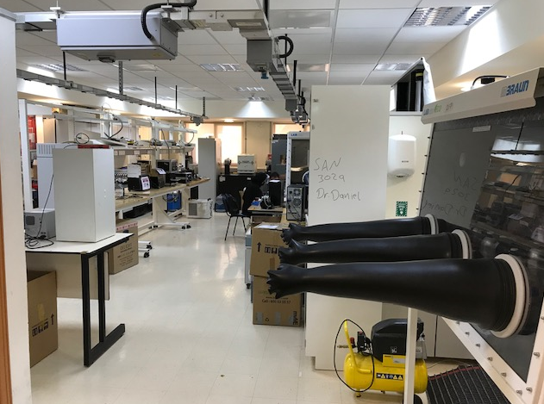
Lab 3019, SAN
KUTC Lab, SAN
Electricity is not available yet

